Slide 1

Exploration Through Virtual and Augmented Reality

Slide 2

Introduction To Augmented and Virtual Reality :
Virtual Reality is a computer simulated reality which replicates a real environment, and simulate a user's physical presence in this environment while,
Augmented Reality blurs the line between what's real and what's computer-generated by enhancing what we see, hear and feel.

Slide 3
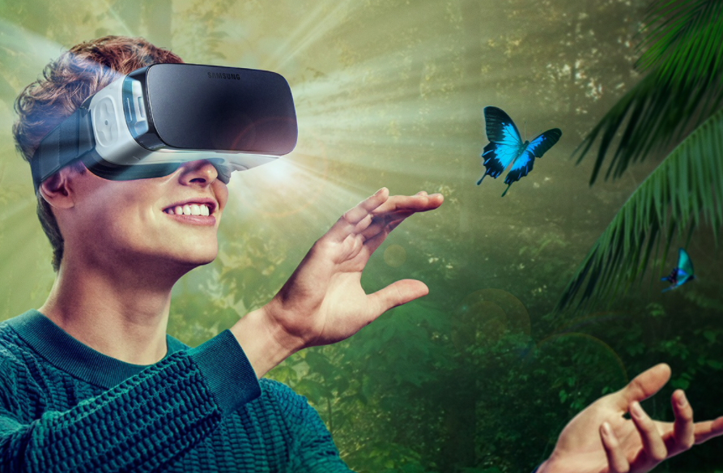
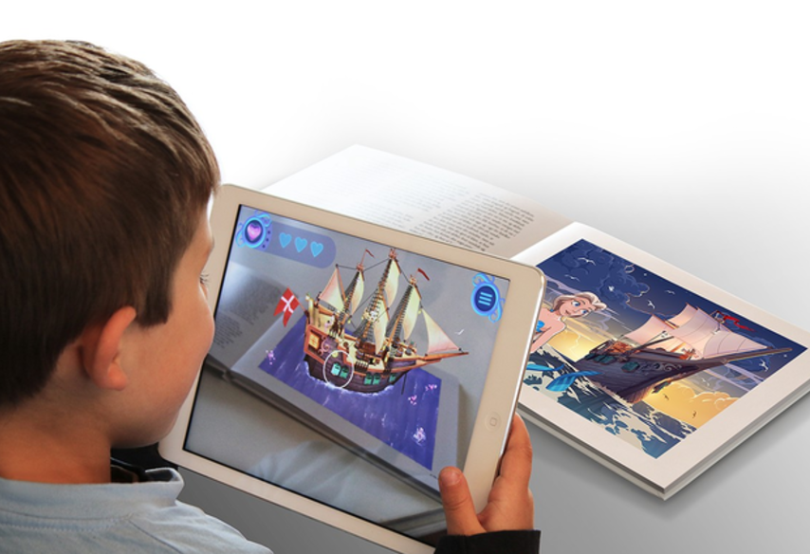

Slide 4

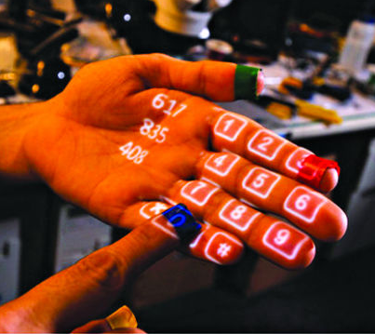
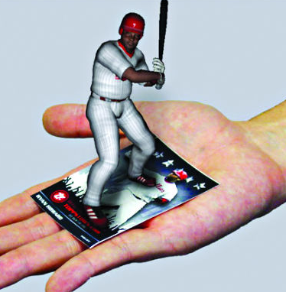
Types of Augmented Reality
Projection Based AR
Recognition Based AR

Slide 5
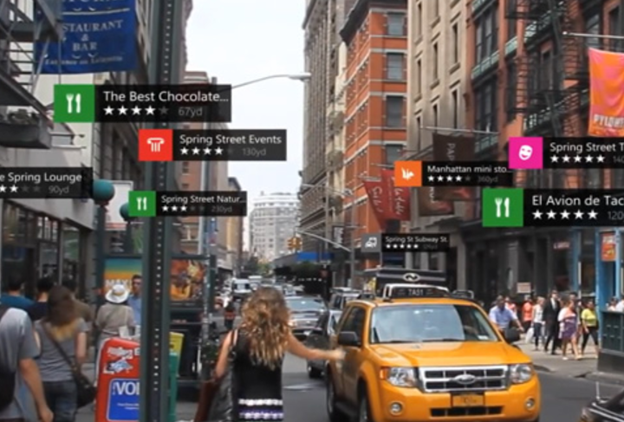
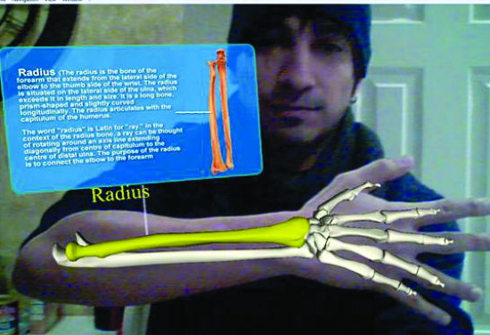
Location Based AR
Superimposition Based AR

Slide 6
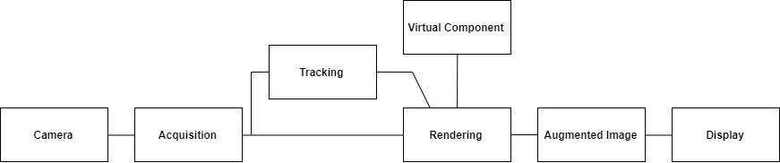
Architecture of Augmented Reality

Slide 7
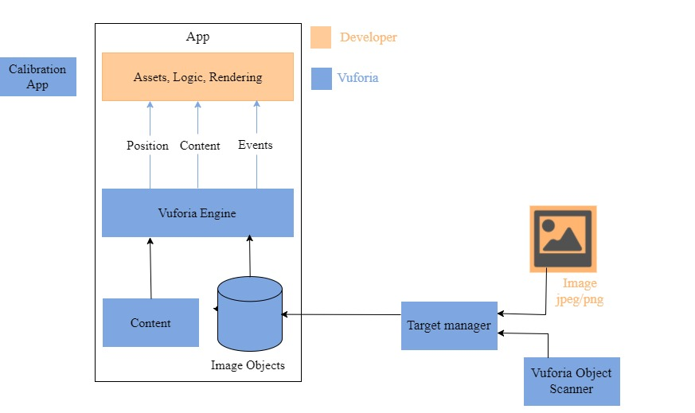
System Design

Slide 8

Project Objective
The objective of the project is to find what can be the applications of Virtual Reality and Augmented Reality in the field of Education. Hence, to build different applications that that will give interactive and immersive learning experience.

Slide 9

Project Idea
Virtual Reality - Tour Through the jungle
Augmented Reality - 1. Storytelling
2. Wonders of the world
3. Engineering Drawing
4. Cube Problem

Slide 10

Hardware/Software Requirements
Unity3D (Personal edition)
Vuforia
C#
VR Headset
Smartphone with Gyroscope and Magnetometer
sensor

Slide 11

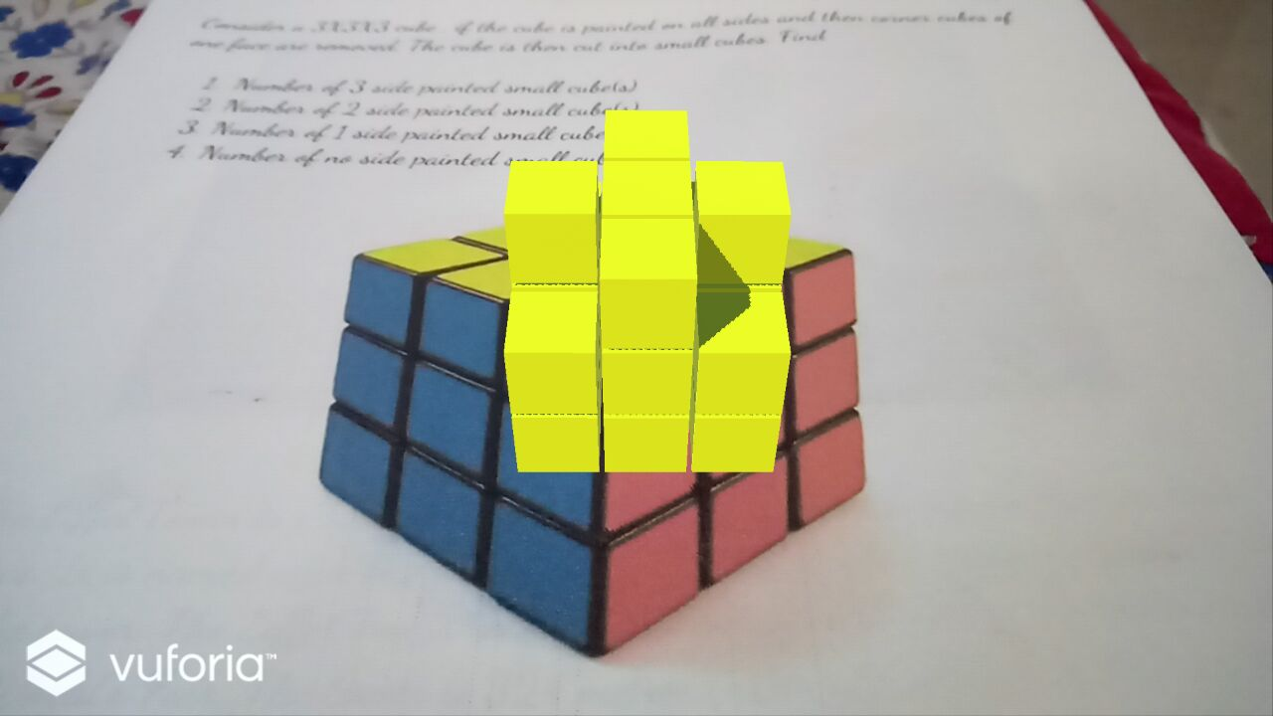
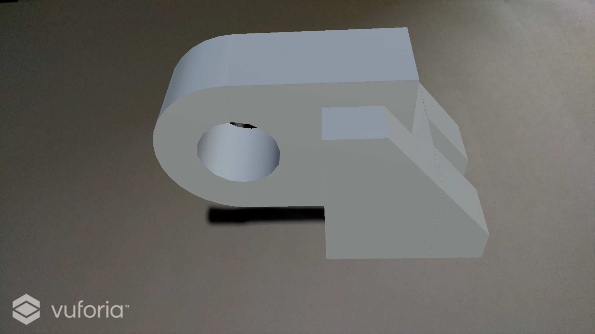
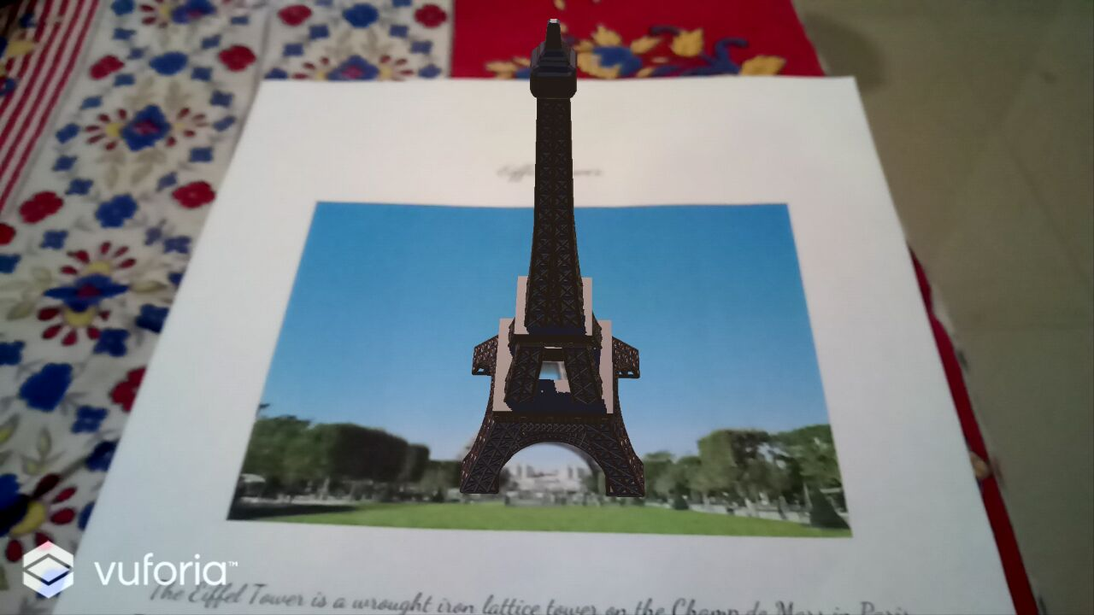
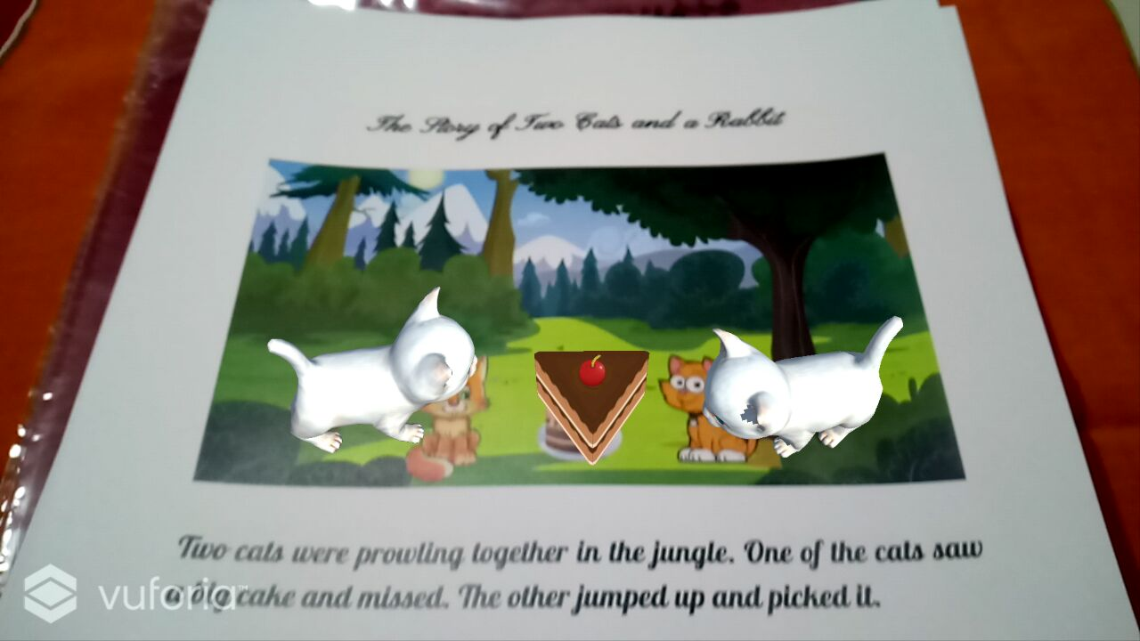
Project Outcomes

Slide 12
Thank You

